Slide 1
Digital Signal Processing Final Term Report
Mekhla Sarkar
Student Id: D0829005
15062020

Slide 2
Overview
DSP Homework
Research Progress
Source : https://github.com/AllenDowney/ThinkDSP

Slide 3
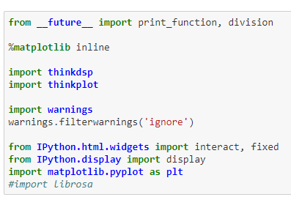
Required Libraries

Slide 4
DSP Homework : Chapter 1
It mainly covers the below topics
Required libraries
Taking audio file as input
Discusses about waves, spectrums and interaction
Audio segmentation
Effect on audio using High pass and Low pass filter
Synthesizing Sine and Cos signal
Speeding up or slowing down wave

Slide 5
DSP Homework : Chapter 1
Question 1
Go to http://freesound.org and download a sound sample that includes music, speech, or other sounds that have a well-defined pitch.
Select a roughly half-second segment where the pitch is constant.
Compute and plot the spectrum of the segment you selected.
What connection can you make between the timbre of the sound and the harmonic structure you see in the spectrum?
Use high_pass, low_pass, and band_stop to filter out some of the harmonics.
Then convert the spectrum back to a wave and listen to it. How does the sound relate to the changes you made in the spectrum?

Slide 6
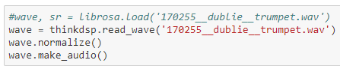

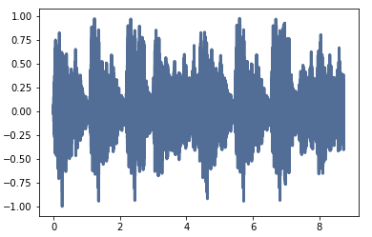
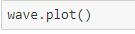
Solution: Question 1
Go to http://freesound.org and download a sound sample that includes music, speech, or other sounds that have a well-defined pitch.
Audio :
for ploting the data

Slide 7
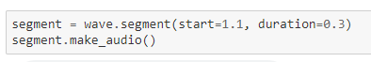
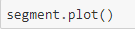
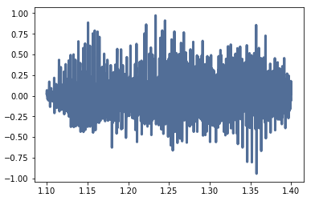
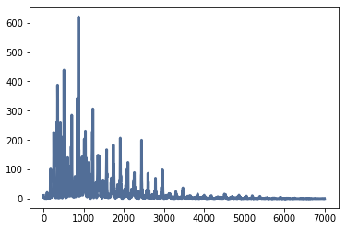
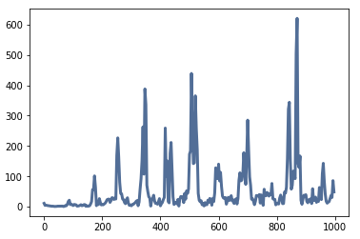
Solution: Question 1
Select a roughly half-second segment where the pitch is constant.
Audio :
Compute and plot the spectrum of the segment you selected.
high=7000
high=1000

Slide 8
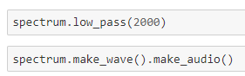
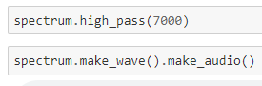
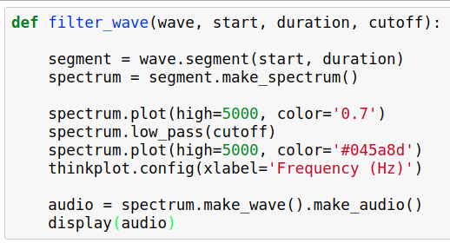
Solution: Question 1
Use high_pass, low_pass, and band_stop to filter out some of the harmonics.
Low Pass
High Pass
Audio :
Audio :
Then convert the spectrum back to a wave and listen to it. How does the sound relate to the changes you made in the spectrum?
Audio :

Slide 9
DSP Homework : Chapter 1
Question 2
Synthesize a compound signal by creating SinSignal and CosSignal objects and adding them up.
Evaluate the signal to get a Wave, and listen to it.
Compute its Spectrum and plot it.
What happens if you add frequency components that are not multiples of the fundamental?

Slide 10
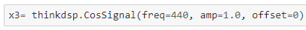
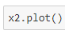
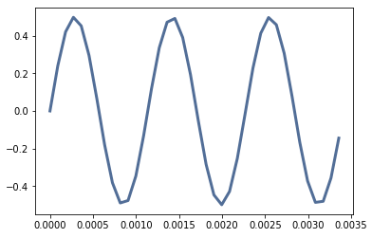
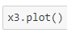
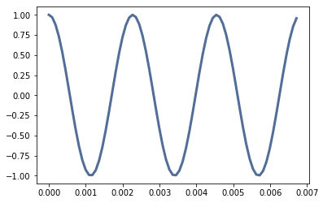
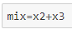
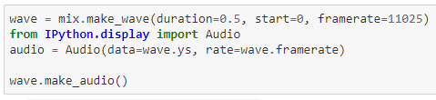
DSP Homework : Chapter 1
Synthesize a compound signal by creating SinSignal and CosSignal objects and adding them up.
Sine Signal
Cos Signal
+
Audio :

Slide 11
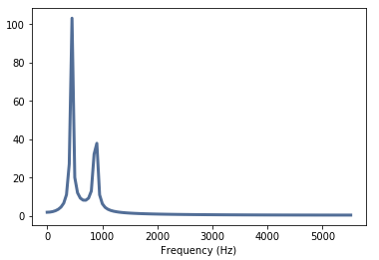
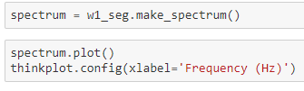
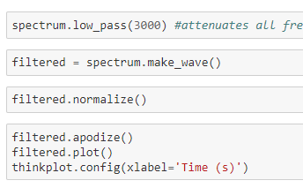
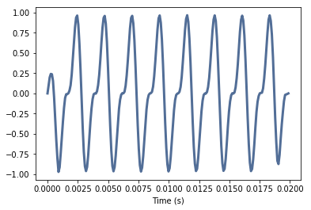
DSP Homework : Chapter 1
Compute its Spectrum and plot it.
Filtering operation on signal
Filtered Audio :
Unfiltered Audio :

Slide 12
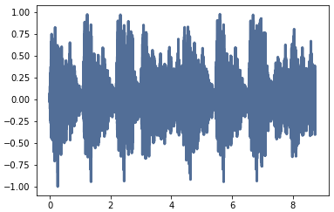
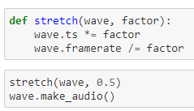
DSP Homework : Chapter 1
Write a function called stretch that takes a Wave and a stretch factor and speeds up or slows down the wave by modifying ts and framerate.
Stretch factor = 0.5
Stretch factor = 1.5
Stretch factor = 3.5
Audio :
Audio :
Audio :

Slide 13
DSP Homework : Chapter 2
It mainly covers the below topics
Required libraries
Different form of signal like
Sawtooth
Square
Triangle,
Parabolic

Slide 14
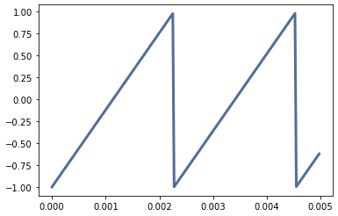
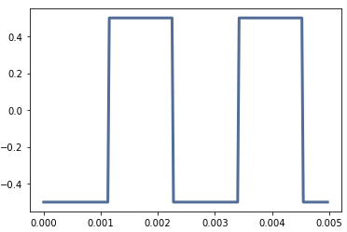
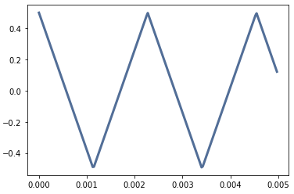
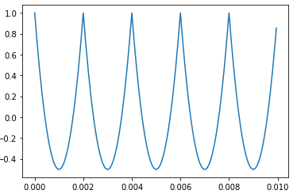
DSP Homework : Chapter 2: Different Signal
Sawtooth Signal
Square Signal
Audio :
Audio :
Triangle Signal
Parabolic Signal
Audio :
Audio :

Slide 15
DSP Homework : Chapter 2
A sawtooth signal has a waveform that ramps up linearly from -1 to 1, then drops to -1 and repeats. See http://en.wikipedia.org/wiki/Sawtooth_wave
Write a class called SawtoothSignal that extends Signal and provides evaluate to evaluate a sawtooth signal.
Compute the spectrum of a sawtooth wave. How does the harmonic structure compare to triangle and square waves?

Slide 16
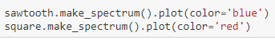
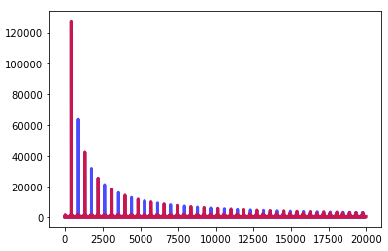
DSP Homework : Chapter 2
Plotting Sawtooth Signal and Square Signal
Compared to a square wave, the sawtooth drops off similarly, but it includes both even and odd harmonics. To make square wave and Sawtooth wave comparable, one way can be by cutting the amplitude of the square wave

Slide 17
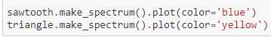
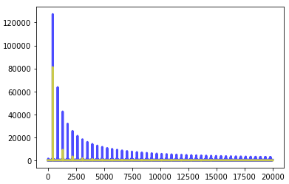
DSP Homework : Chapter 2
Plotting Triangle Signal and Sawtooth Signal

Slide 18
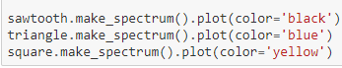
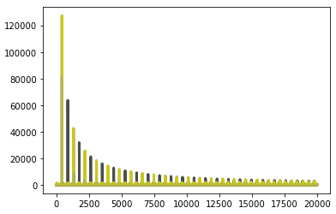
DSP Homework : Chapter 2
Plotting Triangle Signal, Sawtooth and Square Signal
Plotting Sawtooth Signal and Square Signal
Plotting Triangle Signal and Sawtooth Signal

Slide 19
DSP Homework : Chapter 3
It mainly covers the below topics
Chirp
Exponential Shirp
Sawtooth Chirp
Leakage
Different windows present in Numpy for leakage
blackman
bartlett
hamming
hanning

Slide 20
DSP Homework : Chapter 3
Run and listen to the examples in chap03.ipynb. In the leakage example, try replacing the Hamming window with one of the other windows provided by NumPy, and see what effect they have on leakage.

Slide 21
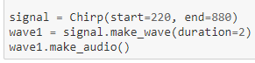
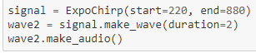
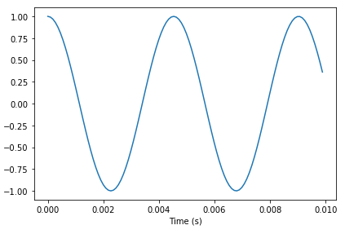
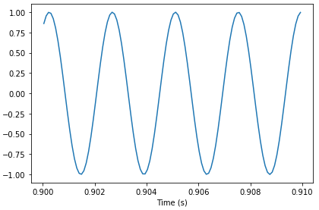
DSP Homework : Chapter 3
Chirp
Exponential Chirp
Audio :
Audio :

Slide 22
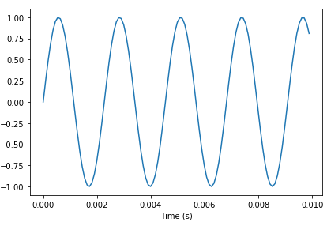
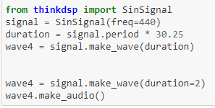
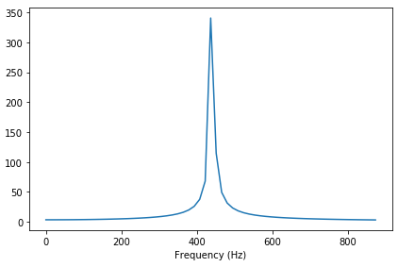
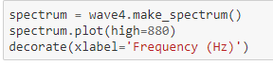
DSP Homework : Chapter 3
Leakage
Audio :
Plot leakage based on frequency

Slide 23
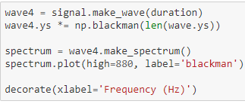
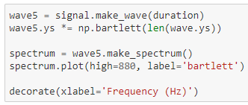
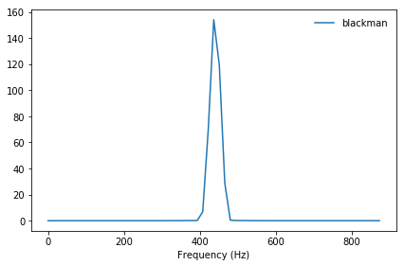
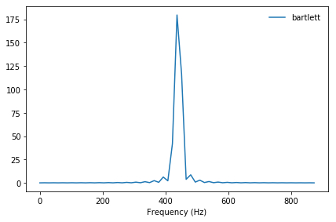
DSP Homework : Chapter 3
Blackman
Exponential Chirp

Slide 24
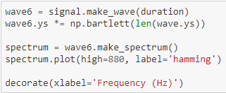
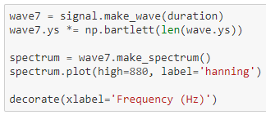

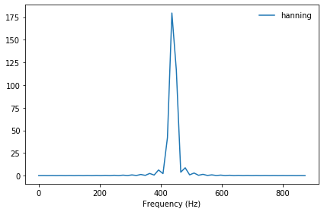
DSP Homework : Chapter 3
Hamming
Hanning

Slide 25


DSP Homework : Chapter 3
Comparing 1.Blackman 2. Bartlet 3. Hamming 4. Hanning

Slide 26



DSP Homework : Chapter 3
Function for defining Sawtooth Chirp
Audio :

Slide 27
DSP Homework : Chapter 3
Chirp
Exponential Chirp
Sawtooth Chirp
Audio :
Audio :
Audio :

Slide 28
DSP Homework : Chapter 4
It mainly covers the below topics
Power Spectrum
Different types of noise
White Noise Signal
Pink Noise Signal
Brown Noise Signal
Leakage
Different windows present in Numpy for leakage
blackman
bartlett
hamming
hanning

Slide 29



DSP Homework : Chapter 4
White Noise
Checking whether the generated wave signal contains white noise or not.
Ans : If white noise then a straight line
Audio :

Slide 30


DSP Homework : Chapter 4
Pink Noise
Pink noise or ​1⁄f noise is a signal or process with a frequency spectrum such that the power spectral density (energy or power per frequency interval) is inversely proportional to the frequency of the signal.
Pink noise is one of the most common signals in biological systems.
Audio :

Slide 31


DSP Homework : Chapter 4
Brownian Noise
Brownian noise, also known as Brown noise or red noise, is the kind of signal noise produced by Brownian motion, hence its alternative name of random walk noise.
Audio :

Slide 32


DSP Homework : Chapter 4
Comparing White, Pink And Brownian Noise Signal

Slide 33


DSP Homework : Chapter 4
Comparing the downloaded segmented wave signal with white noise, pink noise and brownian noise

Slide 34





DSP Homework : Chapter 4
How does the spectrum vary over time?
Step 1: Segmenting the downloaded wave into 3 segments: segment1, segment2, segment3
Step 3: Calculating Spectrum of the three segments and plotting them
(without log scaling)
(with log scaling)

Slide 35



DSP Homework : Chapter 4
Implement bartlett's method and use it to estimate the power spectrum for a noise wave.
(without log scaling)
(with log scaling)
bartlett_method makes a spectrogram and extracts spec_map, which maps from times to Spectrum objects. It computes the PSD for each spectrum, adds them up, and puts the results into a Spectrum object.

Slide 36
DSP Homework : Chapter 5
It mainly covers the below topics
Autocorrelation
Periodic Behavior

Slide 37


DSP Homework : Chapter 5
Compute the autocorrelation of BitCoin prices. Does the autocorrelation function drop off quickly? Is there evidence of periodic behavior?
Source of bitcoin data : https://github.com/RoliSoft/Market-Prediction
Here's the autocorrelation function using the statistical definition, which unbiases, normalizes, and standardizes; that is, it shifts the mean to zero, divides through by standard deviation, and divides the sum by N.

Slide 38

DSP Homework : Chapter 5

Slide 39



DSP Homework : Chapter 5

Slide 40



DSP Homework : Chapter 5
Encapsulate the code in Qs 1 in a function called estimate_fundamental, and use it to track the pitch of a recorded sound.
Audio :

Slide 41



DSP Homework : Chapter 5
To find the highest peak in the autocorrelation function
After Plotting
loop for tracking the pitch over the sample.
The ts are the mid-points of each segment.

Slide 42
DSP Homework : Chapter 6
It mainly covers the below topics
How to synthesize a mixture of sinusoids and evaluate them
Adding up signal
Matrix multiplication
Analyze a signal
Discrete Cosine Transform(DCT)

Slide 43


DSP Homework : Chapter 6
Adding up signal

Slide 44


DSP Homework : Chapter 6
Matrix multiplication

Slide 45
DSP Homework : Chapter 6
In this chapter I claim that analyze1 takes time proportional to and analyze2 takes time proportional to . To see if that's true, run them on a range of input sizes and time them. In IPython, you can use the magic command %timeit.
If you plot run time versus input size on a log-log scale, you should get a straight line with slope 3 for analyze1 and slope 2 for analyze2. You also might want to test dct_iv and scipy.fftpack.dct.

Slide 46

DSP Homework : Chapter 6
Input : Gaussian noise signal
The following function takes an array of results from a timing experiment, plots the results, and fits a straight line.

Slide 47



DSP Homework : Chapter 6
Analyze1
Analyze2

Slide 48




DSP Homework : Chapter 6
Analyze1
Analyze2

Slide 49


DSP Homework : Chapter 6
DCT

Slide 50

DSP Homework : Chapter 6
Comparing analyze1,analyze2 & DCT

Slide 51
DSP Homework : Chapter 7
It mainly covers the below topics
How DFT and inverse DFT as matrix multiplications
Comparison of DFT, inverse DFT and FFT

Slide 52
DSP Homework : Chapter 7
The key to the FFT is the Danielson-Lanczos lemma:
Where is the th element of the DFT of ; is the even elements of , and is the odd elements of .
This lemma suggests a recursive algorithm for the DFT:
Given a wave array, , split it into its even elements, , and its odd elements, .
Compute the DFT of and by making recursive calls.
Compute for each value of using the Danielson-Lanczos lemma.

Slide 53



DSP Homework : Chapter 7
a small real signal and compute its FFT:
Result :
DFT implementation :
Result :

Slide 54


DSP Homework : Chapter 7
a recursive FFT
Result : 0.0

Slide 55
DSP Homework : Chapter 8
It mainly covers the below topics
Filtering and Convolution operations
Smoothing operations
Autocorrelation
Convolution Theorem

Slide 56




DSP Homework : Chapter 8
What happens to the Fourier transform as you vary std?
Step 1:Create a Gaussian curve
Step 2: performing FFT on Gaussian curve

Slide 57


DSP Homework : Chapter 8
Step 3: Roll out negative frequencies to the left to check if it is Gaussian, at least approximately.

Slide 58


DSP Homework : Chapter 8
Check Gaussian window and its FFT simultaneously
Output

Slide 59


DSP Homework : Chapter 8
Vary std
As std increases, the Gaussian gets wider and its FFT gets narrower.

Slide 60
DSP Homework : Chapter 9
It mainly covers the below topics
exploring the effect of diff and differentiate on a signal
Differential and integration

Slide 61
DSP Homework : Chapter 9
Create a triangle wave and plot it. Apply the diff operator and plot the result.
Compute the spectrum of the triangle wave, apply differentiate, and plot the result.
Convert the spectrum back to a wave and plot it. Are there differences between the effect of diff and differentiate for this wave?

Slide 62


DSP Homework : Chapter 9
Create a triangle wave and plot it. Apply the diff operator and plot the result.

Slide 63


DSP Homework : Chapter 9
Compute the spectrum of the triangle wave, apply differentiate, and plot the result.

Slide 64


DSP Homework : Chapter 9
Convert the spectrum back to a wave and plot it. Are there differences between the effect of diff and differentiate for this wave?

Slide 65




Comparison of triangle wave, sawtooth wave,square wave and parabolic wave
Square Signal
Sawtooth Signal
Audio before :
Audio after :
Audio before :
Audio after :
Triangle Signal
Parabolic Signal
Audio before :
Audio after :
Audio before :
Audio after :

Slide 66
Review of Deep Learning Models for Image Segmentation
Research Progress

Slide 67
Outline
Introduction to Deep Learning(DL)
Introduction to Segmentation
Dataset Information
Goal
Some Concepts
Different DL architecture for segmentation
Conclusion

Slide 68

Introduction : Deep Learning
Deep Learning
It is a machine learning technique that teaches computers to do what comes naturally to humans: learn by example[1]
The term “deep” usually refers to the number of hidden layers in the neural network[2].
Deep learning models are trained by using large sets of labeled data and neural network architectures that learn features directly from the data without the need for manual feature extraction.

Slide 69






Introduction: Deep Learning
Labeled Data: Image data with labels associated with it[3].
Unlabeled Data : Image data without any labels associated with it[3].

Slide 70


Application of Deep Learning[4]

Slide 71


Image Segmentation[5]
It is the process of partitioning a digital image into multiple segments.
simplifies the representation of an image into something that is more meaningful and easier to analyze.
Image segmentation is the process of assigning a label to every pixel in an image such that pixels with the same label share certain characteristics.
Locating the exact pixels of each object instead of just bounding box
Segmentation

Slide 72




Introduction: Image Segmentation
Input Image
Image Segmentation Algorithm
+
=
Semantic Segmentation
Instance
Segmentation
Panoptic
Segmentation
A task that requires segmenting all the pixels in the image based on their class label.
A task that requires the identification and segmentation of individual instance in an image.
A task to identify the class label for all pixels, as well as identify all the instances in our image

Slide 73
Goal
To introduce different Image Segmentation architectures and compare their results

Slide 74
Dataset
Types of Data Supported
Image
Video
Source of Data
Open Source
Custom Data
Data sample Created by us

Slide 75







Data
Image
Can be used for
Classification
Object detection
Segmentation
Open Data Sources: Image
Sources
MNIST dataset: 1
Fashion MNIST dataset: 1
MS-COCO: 1, 2, 3
CIFAR-10: 1
EMNIST dataset: 1
The Street View House Numbers (SVHN): 2
Warwick: 1,2,3
Open Images Dataset: 1,2
Kaggle: 1,2,3
ImageNet: 1
Sources: https://www.analyticsvidhya.com/blog/2018/03/comprehensive-collection-deep-learning-datasets/

Slide 76
Some Concepts
Convolution
Deconvolution
Pooling
Unpooling

Slide 77


Some Concepts : Convolution
Convolution :
It is defined as an operation on two functions,
s(t) = (I ∗ K)(t)
s(t) =An output (or feature map)
I(t) =input image
*= defines convolution operation
K=a filter or kernel K(a).

Slide 78

Some Concepts : Deconvolution
Also known as Transposed Convolutions.
The inversion of a convolution equation, i.e., the solution for f of an equation of the form
given g and h , where ε is the noise and * denotes the convolution. Deconvolution is ill-posed and will usually not have a unique solution even in the absence of noise[13].
f * g=h + ε
3 | 3 | 2 | 1 | 0
0 | 0 | 1 | 3 | 1
3 | 1 | 2 | 2 | 3
2 | 0 | 0 | 2 | 2
2 | 0 | 0 | 0 | 1
0 | 1 | 2
2 | 2 | 0
0 | 1 | 2
*
Output
Feature
Image
Kernel
http://deeplearning.net/software/theano/tutorial/conv_arithmetic.html

Slide 79


Slide 80


Some Concepts : Pooling
Pooling
It is used to reduce the number of parameters to be calculated, and the size of the image (width and height, but not depth).
Types of Pooling
Max-pooling
Average pooling
L2-normalization pooling
3 | 5
2 | 2
2 | 3
1 | 1
Max
Pooling
Average
Pooling
L2-normalization
Pooling
Image

Slide 81





Some Concepts : Unpooling
Unpooling :
During the pooling operation, create a matrix which records the location of the maximum value, unpool operation will insert the pooled value in the original place, with the remaining elements being set to zero.
Unpooling captures example-specific structures by tracing the original locations with strong activations back to image space.
It effectively reconstructs the detailed structure.
Output
Feature
Input
Feature
Pooling
Unpooling
Input Feature
Output Feature
Store location of the pooling elements

Slide 82

Summary of the concepts

Slide 83
Image Segmentation Architecture[6]
Image Segmentation
FCN
ParseNet
SegNet
UNet
DeconvNet
FPN
PSPNet
DeepLab
FCN = Fully Convolutional Network
FPN = Feature Pyramid Network
DeconvNet = Deconvolution Network
PSPNet = Pyramid Scene Parsing Network

Slide 84

Image Segmentation Architecture: FCN[6]
FCN (Fully Convolutional Network):
J.long et al. developed FCN in 2015.
It contains only convolutional layers which has been trained end-to-end for segmentation of image.
The authors have modified the existing AlexNet, VGG16, GoogLeNet
Input: arbitrary sized image
Key Feature : replaced the fully connected layer with convolution layer with strides equal to 1.
Input Image
224X224
Output Image
224X224

Slide 85

Image Segmentation Architecture: ParseNet[6]
ParseNet:
W. Liu et al. developed ParseNet in 2015.
The author have modified the existing FCN
Input: arbitrary sized image
Key Feature : applied Conditional Random Field on top of FCN and used L2 Normalization.
Input Image
224X224
Output Image
224X224

Slide 86


Comparison of FCN and ParseNet[6]

Slide 87

Image Segmentation Architecture: SegNet[8]
SegNet:
developed by members of the Computer Vision and Robotics Group at the University of Cambridge, UK.
It consists of two parts :
Encoding part: convolutional layers with batch normalization and ReLU as activation function
Decoding part: maxpooling indices for upsampling
Advantage : It retains high frequency details in the segmented images

Slide 88

Image Segmentation Architecture: Unet[9]
UNet:
In 2015,O. Ronneberger et al. have extended the FCN of J. Long et al. (2015) for biological microscopy images.
U-net composed in two parts:
contracting part(upsampling): to compute features
expanding part(downsampling): to spatially localise patterns in the image.

Slide 89

Image Segmentation Architecture: DeconvNet[10]
DeconvNet(Deconvolution Network):
In 2015,O. Ronneberger et al. have extended the FCN of J. Long et al. (2015) for biological microscopy images.
U-net composed in two parts:
contracting part(upsampling): to compute features
expanding part(downsampling): to spatially localise patterns in the image.

Slide 90

Comparison between SegNet,Unet,DenseNet[11]

Slide 91

Image Segmentation Architecture: FPN
FPN (Feature Pyramid Network ):
In 2016, T.-Y. Lin et al (2016) developed FPN and it is used in object detection or image segmentation frameworks.
FPN consists of three parts :-
bottom-up pathway: takes input image of arbitrary size and processes them with convolutional layers and downsampled them using pooling layers
top-down pathway: It consists of upsampling where last feature maps of are unpooled.
lateral connections: in order to join low-resolution and high-resolution features.

Slide 92

Image Segmentation Architecture: FPN
PSPNet (Pyramid Scene Parsing Network ):
In 2016,H. Zhao et al. (2016) have developed PSPNet
Purpose : to better learn the global context representation of a scene.
Patterns are extracted from the input image using a feature extractor with a dilated network strategy.
The feature maps feed a Pyramid Pooling Module to distinguish patterns with different scales.

Slide 93

Image Segmentation Architecture: DeepLab
DeepLab:
In 2017, L.-C. Chen et al. inspired by the FPN model, have released DeepLab Purpose : to better learn the global context representation of a scene.
It consists of encoder and decoder.
Key Feature: combining atrous convolution, spatial pyramid pooling and fully connected CRFs.
There are four variations: DeepLab, DeepLabv2, DeepLabv3, DeepLabv3+.

Slide 94

Comparison Result of Different Architecture

Slide 95
References
[1]https://www.forbes.com/sites/bernardmarr/2018/10/01/what-is-deep-learning-ai-a-simple-guide-with-8-practical-examples/#3f3d6fd88d4b
[2] https://www.mathworks.com/discovery/deep-learning.html
[3] https://en.wikipedia.org/wiki/Deep_learning
[4] https://machinelearningmastery.com/applications-of-deep-learning-for-computer-vision/
[5] https://en.wikipedia.org/wiki/Image_segmentation
[6]https://medium.com/@arthur_ouaknine/review-of-deep-learning-algorithms-for-image-semantic-segmentation-509a600f7b57
[7] Liu W, Rabinovich A, Berg AC. Parsenet: Looking wider to see better.arXiv preprint arXiv:1506.04579. 2015 Jun 15.
[8] https://mi.eng.cam.ac.uk/projects/segnet/
[9] https://medium.com/@sunnerli/simple-introduction-about-hourglass-like-model-11ee7c30138
[10] https://ai-pool.com/m/deconvnet-1555689073
[11] https://towardsdatascience.com/review-segnet-semantic-segmentation-e66f2e30fb96
[12]http://web.eng.tau.ac.il/deep_learn/wp-content/uploads/2017/12/Rethinking-Atrous-Convolution-for-Semantic-Image-Segmentation-1.pdf
[13] https://mathworld.wolfram.com/Deconvolution.html

Slide 96
Thank you

